Slide 1
Introduction to Computers and Programming (CSC 103)
To understand computer science concepts and to become familiar with programming languages.
To get familiar with typical C++ Program development environment.
Recommended Books: Object Oriented Programming in C++ , Robert Lafore.
Reference Book: How to C++ Program, By Deitel and Deitel.

Slide 2
Week -1
Introduction to Computers
Hardware and Software.
Storage devices.
Operating Systems.
Lab Activity on MS office

Slide 3
Computer:
Electronic machine
Accepts information
Stores it
Processes the information
Returns the results to user
Store and manipulate large quantities of data.
Makes decisions based on simple comparisons.

Slide 4
Cont’d
[Norton] A Computer is an electronic device that processes data, converting it into information that is useful to people.
[Wikipedia] A Computer is a programmable device, usually electronic in nature, that can store, retrieve and process data.

Slide 5
Processing / Computation
Input
Output

Slide 6
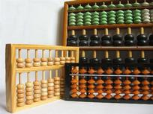
History of Computers:
Advances made by science and technology have depended upon the ability to process large amount of data and perform complex mathematical calculations.
First computing device was ABACUS.

Slide 7
Cont’d
First computer like machine was the Mark I developed by a team from IBM and Harvard University.
It used to operate on mechanical telephone relays and do processing on punch cards.
June 1943 work began on world’s first electronic computer. Built at University of Pennsylvania as a secret Military Project during world war II.
It used vacuum tubes instead of relay switches.

Slide 8
Cont’d
Invention of transistors made smaller and less expensive computers possible. But still huge by today’s standards.
Another innovation to computers was storing data on tape instead of punch cards.
This gave computers the ability to store and retrieve data quickly and reliably.

Slide 9
Classification of Computers:
Super Computers
Mainframes
Minicomputer
Personal Computers

Slide 10
Super Computers:
Biggest in size
Most expensive in price
Process trillions of instructions
Industrial Purpose usage
Defense
Hollywood movies
Weather forecasting

Slide 11
Mainframes:
Giant in computers after Super Computers.
Process millions of instructions.
Access billion of data per second.
Big hospitals, airline Reservations.
Very Expensive.

Slide 12
Minicomputers:
Much smaller than mainframe computers.
They posses most of features found on mainframe computers but on a more limited scale.
Medium and small businesses use these computers.

Slide 13
Microcomputers/Personal Computers
Most familiar type of computers.
Available in form of desktops and laptops.
terribly limited in what they can do when compared to the larger models.
But excellent when used in small businesses, homes and varsities.
Indispensable part of our daily life.

Slide 14
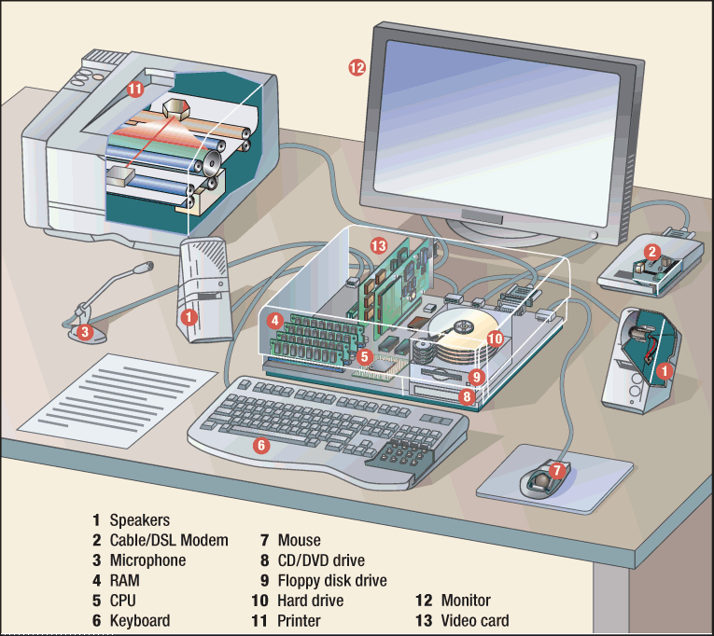
Hardware:
The hardware are the part of the computer you can touch and see.

Slide 15
Software:
Software is a part of the computer you cannot touch.
Software consist of computer programs and procedures that perform some tasks on your computer.
Computer software is divided into three basic types.

Slide 16
System Software:
A group of programs that coordinate and control the resources and operations of a computer system.
Enables all components of the computer system to communicate.
Operating System (OS): provide an interface between the user or application program and the computer hardware.
Win 95/98/2000
Mac System 6/7
Utility programs: help you perform housekeeping chores; complete specialized tasks related to managing the computer’s resources, file management, and so on.
GUI (graphical user interface): graphical symbols (icons) represent files, disks, programs, and other objects.

Slide 17
Application Software:
Programs that work with the OS software to help you use your computer to do specific types of work.
Categories:
Business
Communications
Graphics and Multimedia
Education and Reference
Entertainment and Leisure
Integrated Programs

Slide 18
Cont’d:
Business Software
Word Processing
program that allows you to create, edit, and print text documents
Report, flyer, memo
Spreadsheet
Numbered Rows and Lettered Columns
Intersection of them = cell
Grade book, financial info
Database
Lets you set up an electronic filing systems
Enter text and numbers
Find, search, and printer info in different ways
Address book, Card Catalog

Slide 19
Cont’d:
Communications
Works with modems or network hardware and allows our computer to communicate with other computers.
Exchange computer files and email.
Graphics Software
Uses pictures or images to help communicate messages.
Multimedia: combines text, graphics, animation, video, and audio.
Clip art: graphical images to be added to documents.

Slide 20
Cont’d:
Education & Reference
Available on many topics
Help
Easier
Quicker
Examples: AR, Encyclopedia, etc.
Entertainment & Leisure
Fun
Games and simulations
Tests your skills
Interactive

Slide 21
Cont’d:
Integrated Software:
Combine several software applications into one program.
Work Processing
Spreadsheet
Database
Communication
Examples:
MS Works
MS OFFICE
Lotus SmartSuite

Slide 22
Programming software
Programming software provides tools to assist a computer programmer in writing programs and software.

Slide 23
System Components:
Central Processing Unit (CPU): the microprocessor, the brains of the computer.
Housed on a tiny silicon chip
Chip contains millions of switches and pathways that help your computer make important decisions.
CPU knows which switches to turn on and which to turn off because it receives its instructions from computer programs (software).
CPU has two primary sections:
Arithmetic/logic unit
Control unit
Arithmetic/logic unit (ALU): performs arithmetic computations and logical operations; by combining these two operations the ALU can execute complex tasks.
Arithmetic operations include addition, subtractions, multiplication, and division.
Logical operations involve comparisons.
Control Unit: is the “boss” and coordinates all of the CPU’s activities.
Uses programming instructions, it controls the flow of information through the processor by controlling what happens inside the processor.
We communicate with the computer through programming languages.
COBOL, C++, or VisualBasic.net, HTML, Java Script for example.

Slide 24
Cont’d:
Memory: found on the motherboard; short term and long term.
Random Access Memory (RAM): memory on the motherboard that is short term; where data, information, and program instructions are stored temporarily on a RAM chip or a set of RAM chips.
When the computer is turned off or if there is loss of power, what ever is stored in RAM disappears.
This memory know as the main memory and is considered volatile.
The computer can read from and write to RAM.
Read-Only Memory (ROM): memory on the motherboard that is long term; where the specific instructions that are needed for the computer to operate are stored.
This memory is nonvolatile and your computer can only read from a ROM chip.
The instructions remain on the chip regardless if the power is turned on or off.
Most common is the BIOS ROM; where the computer uses instructions contained on this chip to boot or start the system when you turn on your computer.

Slide 25
Cont’d:
Basic Controllers: on the motherboard, a device that controls the transfer of data from the computer to a peripheral device and vice versa.
Examples: keyboards, mouse, monitors, and printers.
Generally stored on one single chip.
Serial and Parallel Ports: used to connect our peripheral devices to the computer; usually one serial and one parallel port on a computer.
Serial devices transmit data one bit at a time.
A modem may be connected to this port.
Parallel devices transfer several bits at a time.
A printer may be connected to this port.

Slide 26
Cont’d:
Universal Serial Bus (USB): a new standard that supports data transfer rates of up to 12 million bits per second.
A single USB port can be used to connect up to 127 peripheral devices
Expected to replace serial and parallel ports in the near future.
Expansion Slots: an opening on the motherboard where a circuit board or expansion board can be inserted.
Examples: Additional Memory, video cards, modem cards, and sound cards.

Slide 27
End of lecture 1:

Slide 28
Storage Devices:
Magnetic storage devices use oxide-coated plastic storage media called Mylar.
As the disk rotates in the computer, an electromagnetic read/write head stores or retrieves data in circles called tracks.
Tracks are numbered from the outside to the inside and as data is stored on the disk it is stored on one of these numbered track.
Each track is labeled and the location is stored in a log on the disk known as a file allocation table (FAT).

Slide 29
Types of Storage Devices:
Hard Disk Drive: used to store data inside of the computer.
Magnetic platter that holds a large amount of information in a form the computer can understand.
Accessing data is faster
Amount of data that can be stored is much more than what can be stored on a floppy disk.
Size of Hard drive is measured in megabytes or gigabytes.

Slide 30
Cont’d:
Floppy Disk: flat circles of iron oxide-coated plastic enclosed in a hard plastic case.
Most are 3 ½ inches and have a capacity to hold 1.44 MB or more of data.
Zip Disk: capable of storing tremendous amounts of information
- They are only the size of a 3 inch disk but can hold as much as 1 gigabyte of data

Slide 31
Cont’d:
Magnetic Tape Drives: used for making backup copies of large volumes of data.
Very slow
Can be used to replace data that may have been lost on the hard drive
look similar to audio tapes.
Holds more than Floppy.
Optical discs: use laser technology to read and write data on silver platters.
CD-ROM (Compact Disk Read-Only Memory) can store up to 800MB of information/data.
You can only read data from a CD
You can store data on a CD only if you have a CD Burner and writable CDs (CD-R or recordable CD-ROM)
DVD (Digital Versatile Disk) is the size of a regular CD and can be played in a regular CD or in a DVD movie player.

Slide 32
Operating System:
A program that controls the execution of application programs.
An interface between applications and hardware

Slide 33
Operating System Objectives:
Convenience
Makes the computer more convenient to use
Efficiency
Allows computer system resources to be used in an efficient manner
Ability to evolve
Permit effective development, testing, and introduction of new system functions without interfering with service

Slide 34
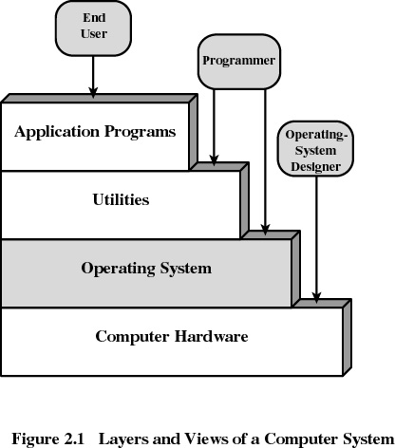
Layers of Computer System:

Slide 35
Types of Operating System:
Real-time operating system
Very fast small OS
Built into a device
Respond quickly to user input
MP3 players, Medical devices

Slide 36
Single user/Single tasking OS
One user works on the system
Performs one task at a time
MS-DOS and Palm OS
Take up little space on disk
Run on inexpensive computers
Operating System cannot be able to take control back from the running process/task/application
In case if a process call an I/O Instruction then Processor must wait for I/O instruction to complete before preceding

Slide 37
Single user/Multitasking OS
User performs many tasks at once
Most common form of OS
Windows XP and OS X
Require expensive computers
Tend to be complex

Slide 38
Multi user/Multitasking OS
Many users connect to one computer
Each user has a unique session
UNIX, Linux, and VMS
Maintenance can be easy
Requires a powerful computer

Slide 39
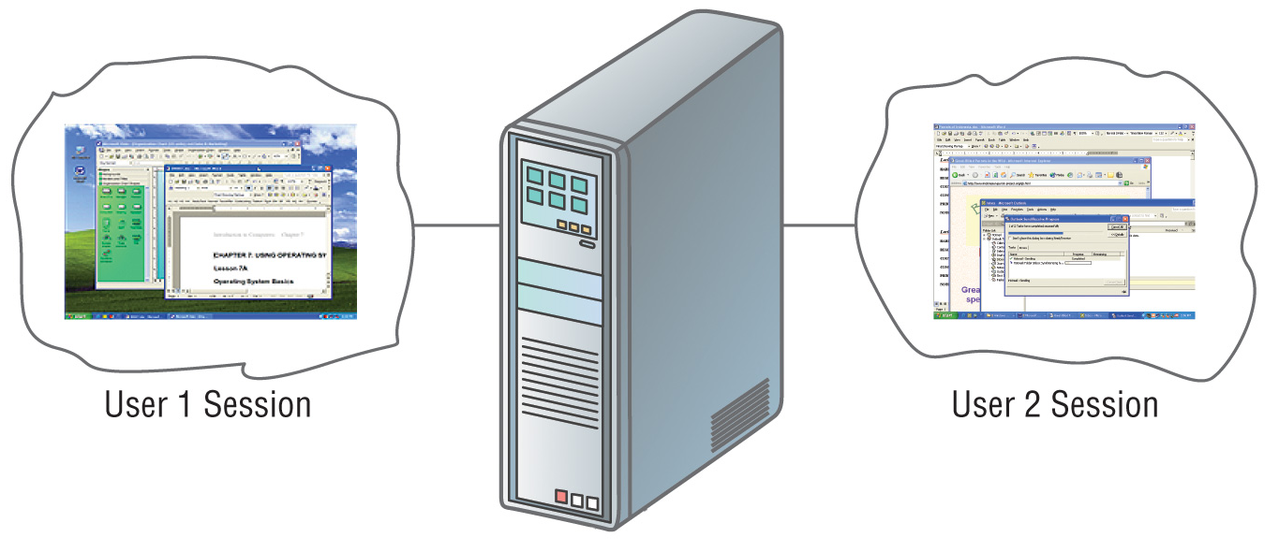

Slide 40
Data Communication
Networks

